Slide 1
Developer’s Journal Pitch
TEAM 29

Slide 2
Problem
Developers face challenges in showcasing their skills effectively to potential employers.
In the competitive modern job market, technical skills are highly sought after, making it difficult for developers to stand out.
The struggle arises from the difficulty of efficiently storing and presenting skills in a visually appealing and engaging manner.
Without a dedicated platform or tool, developers may find it challenging to secure the job opportunities they deserve.

Slide 3
Software Surfers Inc. are proud to present you our product: CodeFolio, a state-of-the-art interactive platform for all developers to showcase their battle-hardened skills and strengths amassed through years of planning/coding/debugging … amazing software applications.
The result of your years of hard work needs a wonderful place to be viewed and appreciated by the world - We Got You :)
For an overview of the platform: checkout the following LucidChart link:
Click Me

Slide 4
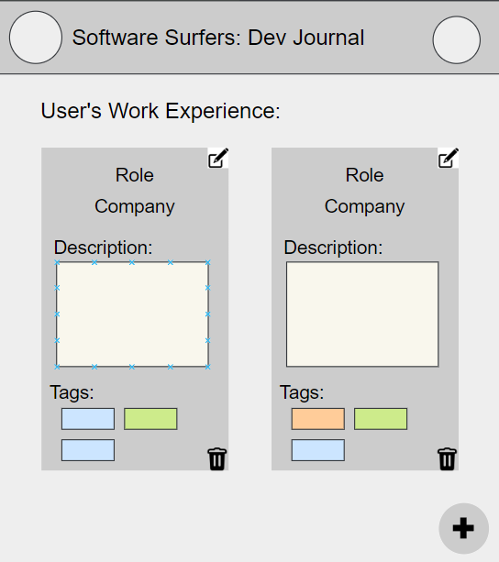
Work Experience Page
Authentication and Navigation:
Users authenticate themselves to access the work experience page within the developer journal. Upon successful login, users navigate to the home page where they can select the "work experience" option.
Functionality:
The work experience page allows users to perform CRUD operations on their work experiences.
The existing work experiences of the user are stored in a database.
Each work experience entry includes fields for the role, company, and description of the experience.
Visualization:
Work experience entries are visually organized into tabs for easy navigation and readability.
Additionally, the page incorporates skill tags associated with each work experience.
Integration with Skill Sheet Page:
Skill tags are dynamically linked to the skill sheet page, providing users with quick access to a comprehensive overview of their skill sets.
User Interaction:
Users can access additional functionalities through the hamburger menu option located on the top right corner of the page.
Options include logging out or navigating to other tabs within the application.

Slide 5
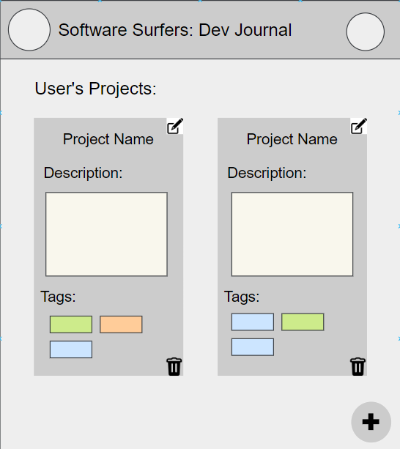
Projects Page
Features - Hamburger menu option, Previously Completed projects, Skill Tags
Operations - The Page allows users to perform CRUD operations with their Projects.
User Navigation - Page can be found on the Home Page after user has logged in.
Visualization - Projects are neatly organized into tabs enhancing visual clarity and ease of navigation around the page.
User’s projects are securely stored on a database facilitating CRUD operations.

Slide 6
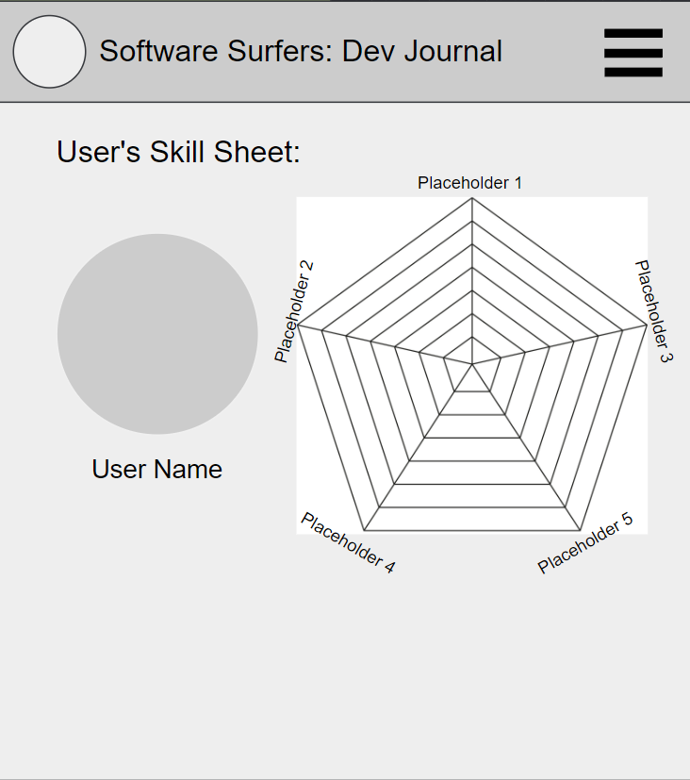
Skills Sheet Page
Features - The user icon and name and the skill display.
Visualization - The skill display is organized in a radar chart that has the names of each skill or technology and plots how much experience the user has.
Functionality - The radar chart would be connected with the users work experiences and projects and the points would be automatically plotted based on all the skill tags used.
User Navigation - The page can be accessed from the homepage or the navigation menu accessed from the hamburger button.

Slide 7
Constraints
Time
Having only 5 weeks alongside other time commitments adds a time constraint to implement and refine everything added
Features Scope Creep
Need to limit amount of features in order to ensure quality and depth in the features we implement
Originality
Many different iterations of the same concept, we need to differentiate and find a niche/reason for our software
Database Limitations
Making use of a database adds many new things to worry about (security and performance), but also introduces problems with scaling the application for large-scale use.

Slide 8
Possible Pitfalls/Rabbit Holes
Focus on developing a single, functioning page before working on a basic layout
Focus on a minimum viable product
Complexity
Overengineering UI
Databases due to lack of experience may become too complex
Learning curves
Learning how to use databases may take time
Multi-factor authentication for data may be too difficult
Security for stored data
Time-consuming to implement/learn
3rd party dependency issues

Slide 9
NO-GOs
Real-Time User Collaborations
We will have real-time interactions but we will not implement real time collaborations between users (live editing)
Offline Functionality
Since we will be using an online database where we need to connect to the internet we will not implement offline functionality
Advanced Security
No super advanced security like multi-factor authentication
Multiple UI Themes
Stick with one theme, no customization that changes the UI

Slide 10
MISSION STATEMENT
Delivering business-oriented, elegant software solutions with a smile on our faces :)

